Slide 1
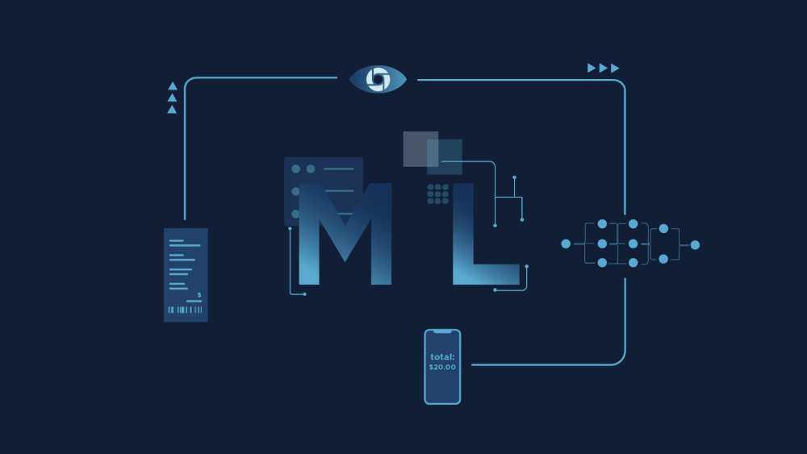
Module 5: MACHINE LEARNING

Slide 2
Content
Basic Concepts of Machine Learning
•Understanding Machine learning
•The Necessity of Machine learning
•Types of Machine learning
Types of Machine Learning
•Supervised machine learning algorithms
•Understanding classification and regression
•Unsupervised machine learning algorithms
•Understanding clustering and associations
•Reinforced machine learning algorithms
Understanding most common machine learning algorithms
•Basic concepts on supervised and un-supervised learning
•Linear regression –Simple and Multiple
•Logistic regression
•Decision tree
•Support vector machine
•Naïve Bayes
•K-Nearest neighbors
•K-Means clustering
•Random forest

Slide 3
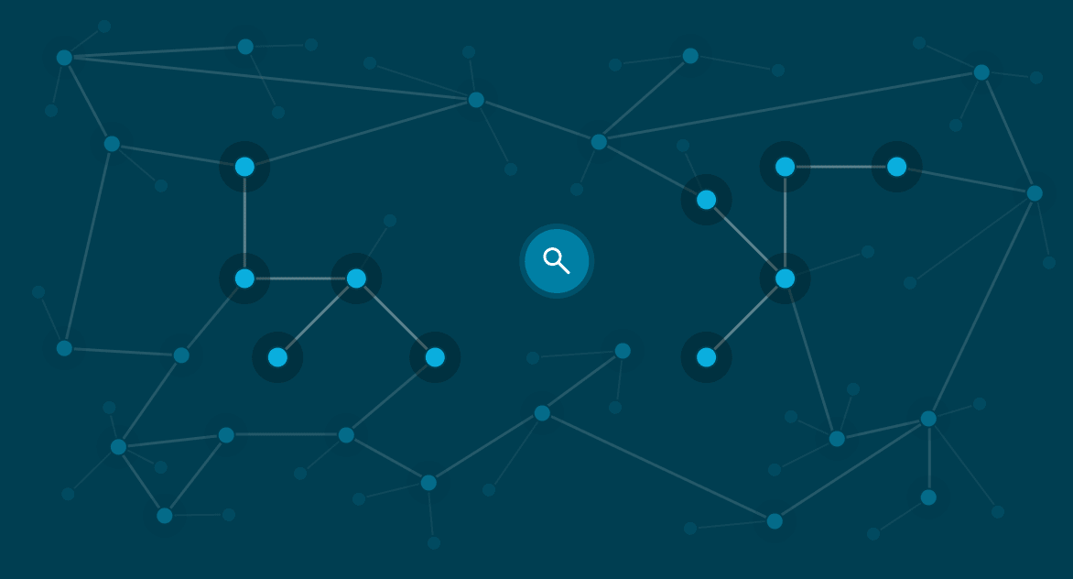
WHAT IS ML?
Machine learning (ML) is a type of artificial intelligence (AI) that allows software applications to become more accurate at predicting outcomes without being explicitly programmed to do so. Machine learning algorithms use historical data as input to predict new output values.

Slide 4
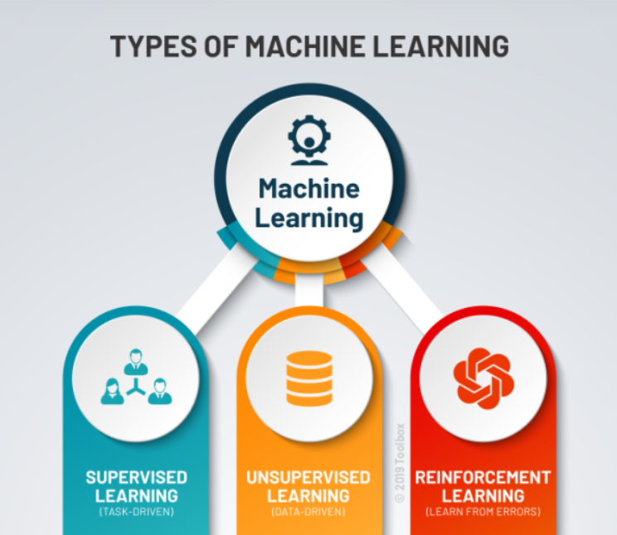

Slide 5
TYPES OF MACHINE LEARNING

Slide 6
Supervised learning
Supervised learning, as the name indicates, has the presence of a supervisor as a teacher. Basically supervised learning is when we teach or train the machine using data that is well labelled.
Which means some data is already tagged with the correct answer. After that, the machine is provided with a new set of examples(data) so that the supervised learning algorithm analyses the training data(set of training examples) and produces a correct outcome from labelled data.
Supervised learning is the types of machine learning in which machines are trained using well "labelled" training data, and on basis of that data, machines predict the output.
The labelled data means some input data is already tagged with the correct output.

Slide 7
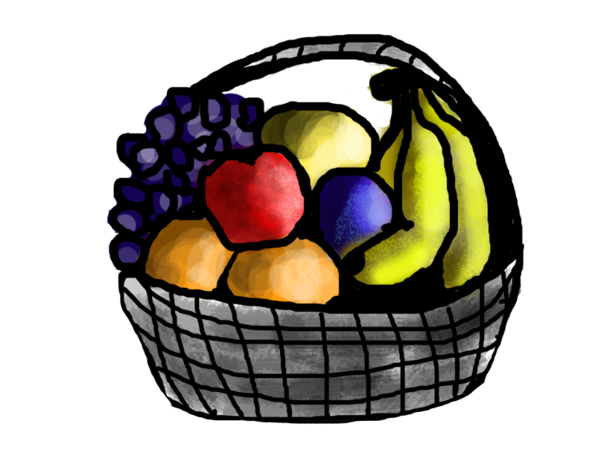
Supervised learning
For instance, suppose you are given a basket filled with different kinds of fruits. Now the first step is to train the machine with all the different fruits one by one like this:
If the shape of the object is rounded and has a depression at the top, is red in color, then it will be labeled as –Apple.
If the shape of the object is a long curving cylinder having Green-Yellow color, then it will be labeled as –Banana.

Slide 8

Supervised learning
Now suppose after training the data, you have given a new separate fruit, say Banana from the basket, and asked to identify it.
Since the machine has already learned the things from previous data and this time has to use it wisely. It will first classify the fruit with its shape and color and would confirm the fruit name as BANANA and put it in the Banana category. Thus the machine learns the things from training data(basket containing fruits) and then applies the knowledge to test data(new fruit).
Supervised learning is classified into two categories of algorithms:
Classification: A classification problem is when the output variable is a category, such as “Red” or “blue” , “disease” or “no disease”.
Regression: A regression problem is when the output variable is a real value, such as “dollars” or “weight”.
Supervised learning deals with or learns with “labeled” data. This implies that some data is already tagged with the correct answer.

Slide 9
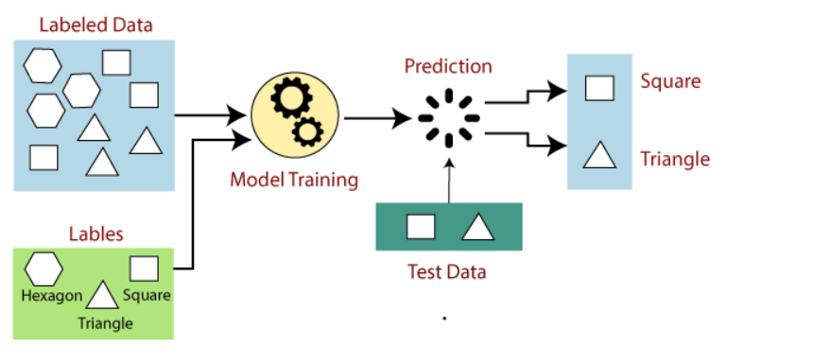
Working of Supervised learning

Slide 10
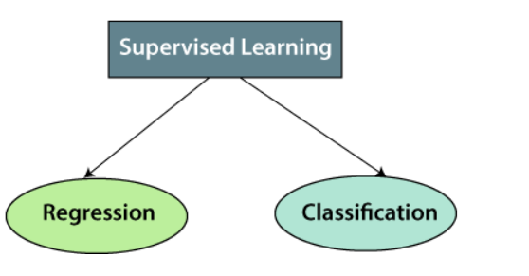
Types of supervised learning
Types:-
Regression
Logistic Regression
Classification
Naive Bayes Classifiers
K-NN (k nearest neighbors)
Decision Trees
Support Vector Machine

Slide 11
Regression
Regression is a technique for investigating the relationship between independent variables and a dependent variable or outcome.
It's used as a method for predictive modelling in machine learning, in which an algorithm is used to predict continuous outcomes

Slide 12
LINEAR REGRESSION
Linear Regression assumes that there is a linear relationship present between dependent and independent variables. In simple words, it finds the best fitting line/plane that describes two or more variables.
There are 2 types of linear regression:
1. Simple Linear Regression
2. Multiple Linear Regression

Slide 13

Applications of Linear Regression in Python
Economic Growth
Linear regression is used to determine the economic growth of a country or a state in the upcoming quarter. It can also be used to predict a nation’s gross domestic product (GDP).

Slide 14

Applications of Linear Regression in Python
Product Price
Linear regression can be used to predict what the price of a product will be in the future, whether prices will go up or down.

Slide 15
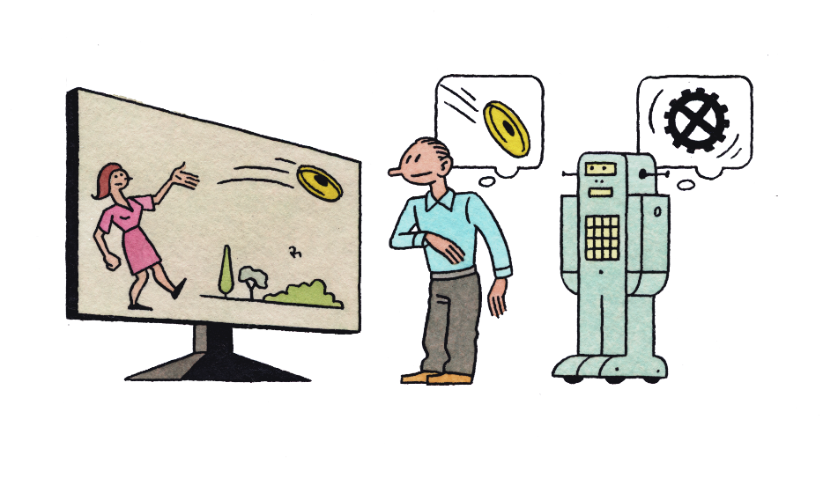
Applications of Linear Regression in Python
Score Predictions
Linear regression can be used to predict the number of runs a baseball player will score in upcoming games based on previous performance.

Slide 16
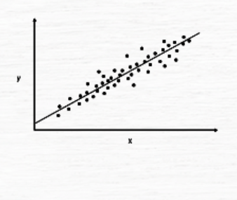
Simple Linear Regression
y = m*x + c

Slide 17
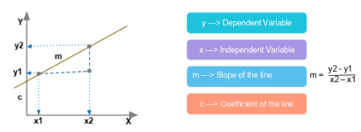
Regression Equation
The simplest linear regression equation with one dependent variable and one independent variable is:
y = m*x + c

Slide 18
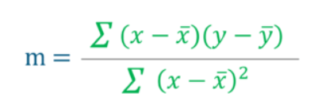
Least Square Method – Finding the best fit line
Regression Line, y = mx+c where,
y = Dependent Variable
x= Independent Variable ; c = y-Intercept

Slide 19
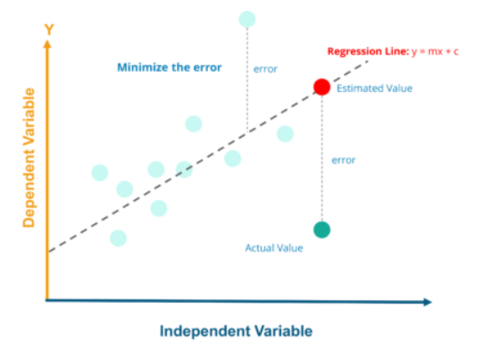
Least Square Method – Implementation using Python for the implementation part, i will be using a dataset consisting of head size and brain weight of different people.

Slide 20
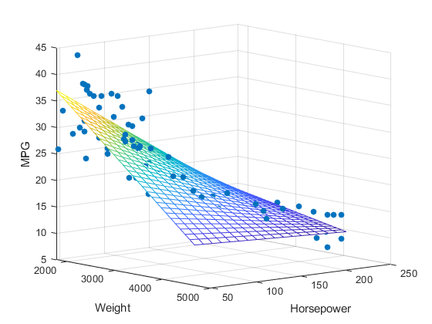
MULTIPLE LINEAR REGRESSION
Multiple linear regression is used to estimate the relationship between two or more independent variables and one dependent variable.
How strong the relationship is between two or more independent variables and one dependent variable
The value of the dependent variable at a certain value of the independent variables.

Slide 21
Multiple Linear Regression
In simple linear regression, we have the equation:
y = m*x + c
For multiple linear regression, we have the equation:
y = m1x1 + m2x2 + m3x3 +........ + c
Here, we have multiple independent variables, x1, x2 and x3, and multiple slopes, m1, m2, m3 and so on.

Slide 22
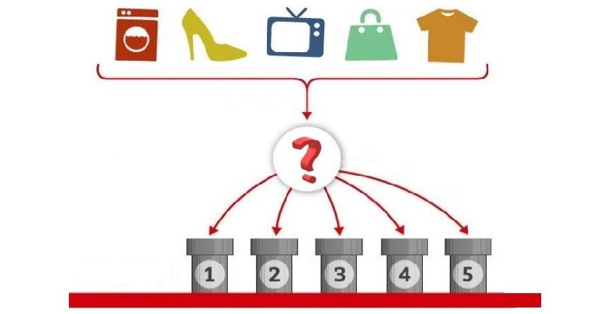
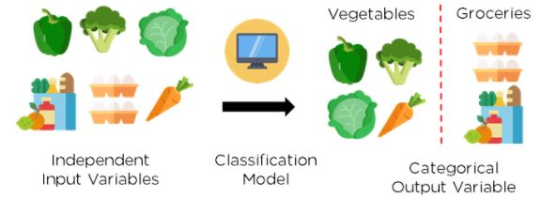
Classification in Machine Learning
Classification is defined as the process of recognition, understanding, and grouping of objects and ideas into preset categories a.k.a “sub-populations.” With the help of these pre-categorized training datasets, classification in machine learning programs leverage a wide range of algorithms to classify future datasets into respective and relevant categories.

Slide 23
Learners in Classification Problems
Lazy Learners
It first stores the training dataset before waiting for the test dataset to arrive. When using a lazy learner, the classification is carried out using the training dataset's most appropriate data. Less time is spent on training, but more time is spent on predictions. Some of the examples are case-based reasoning and the KNN algorithm.

Slide 24
Learners in Classification Problems
Eager Learners
Before obtaining a test dataset, eager learners build a classification model using a training dataset. They spend more time studying and less time predicting. Some of the examples are ANN, naive Bayes, and Decision trees.

Slide 25
Classification
The Classification algorithm is a Supervised Learning technique that is used to identify the category of new observations on the basis of training data.
In Classification, a program learns from the given dataset or observations and then classifies new observation into a number of classes or groups. Such as, Yes or No, 0 or 1, Spam or Not Spam, cat or dog,

Slide 26
4 Types Of Classification Tasks In Machine Learning
Binary Classification
Multi-Class Classification
Multi-Label Classification
Imbalanced Classification

Slide 27
Binary Classification
Those classification jobs with only two class labels are referred to as binary classification.
Examples comprise -
Prediction of conversion (buy or not).
Churn forecast (churn or not).
Detection of spam email (spam or not).
Binary classification problems often require two classes, one representing the normal state and the other representing the aberrant state.
For instance, the normal condition is "not spam," while the abnormal state is "spam." Another illustration is when a task involving a medical test has a normal condition of "cancer not identified" and an abnormal state of "cancer detected.“ Class label 0 is given to the class in the normal state, whereas class label 1 is given to the class in the abnormal condition. A model that forecasts a Bernoulli probability distribution for each case is frequently used to represent a binary classification task.

Slide 28
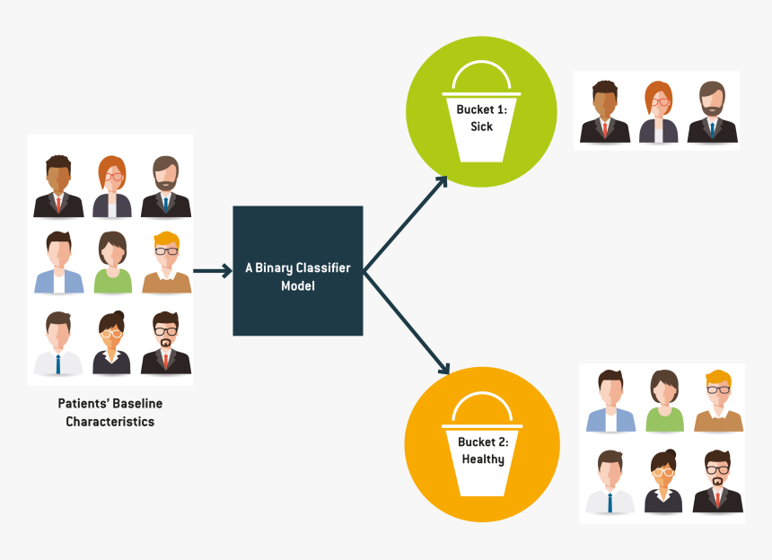
Binary Classification
The following are well-known binary classification algorithms:
Logistic Regression
Support Vector Machines
Simple Bayes
Decision Trees

Slide 29
Multi-Class Classification
Multi-class labels are used in classification tasks referred to as multi-class classification.
Examples comprise -
Categorization of faces.
Classifying plant species.
Character recognition using optical.
The multi-class classification does not have the idea of normal and abnormal outcomes, in contrast to binary classification. Instead, instances are grouped into one of several well-known classes. In some cases, the number of class labels could be rather high. In a facial recognition system, for instance, a model might predict that a shot belongs to one of thousands or tens of thousands of faces.
Text translation models and other problems involving word prediction could be categorized as a particular case of multi-class classification. Each word in the sequence of words to be predicted requires a multi-class classification, where the vocabulary size determines the number of possible classes that may be predicted and may range from tens of thousands to hundreds of thousands of words.

Slide 30
Popular Classification Algorithms
Decision tree
Naive Bayes
K-Nearest Neighbors
Support Vector Machines
Logistic Regression
K means

Slide 31
Multi-Class Classification
For multi-class classification, many binary classification techniques are applicable.
The following well-known algorithms can be used for multi-class classification:
Progressive Boosting
Choice trees
Nearest K Neighbors
Rough Forest / Random Forest
Simple Bayes
Multi-class problems can be solved using algorithms created for binary classification.

Slide 32
Decision tree
Key Terms
Root Node - It represents the entire population or sample and this further gets divided into two or more homogeneous sets.
Splitting - It is a process of dividing a node into two or more sub-nodes.
Decision Node - When a sub-node splits into further sub-nodes, then it is called a decision node.
Leaf/ Terminal Node - Nodes do not split is called Leaf or Terminal node..
Branch / Sub-Tree - A subsection of the entire tree is called branch or sub-tree.
Parent and Child Node - A node, which is divided into sub-nodes is called the parent node of sub-nodes whereas sub-nodes are the child of the parent node.
Entropy - A decision tree is built top-down from a root node and involves partitioning the data into subsets that contain instances with similar values (homogeneous). ID 3 algorithm uses entropy to calculate the homogeneity of a sample. If the sample is completely homogeneous the entropy is zero and if the sample is equally divided it has an entropy of one.
Information Gain - The information gain is based on the decrease in entropy after a dataset is split on an attribute. Constructing a decision tree is all about finding an attribute that returns the highest information gain (i.e., the most homogeneous branches).
Internal Node - An internal node (also known as an inner node, inode for short, or branch node) is any node of a tree that has child nodes
Branch - The lines connecting elements are called "branches".

Slide 33
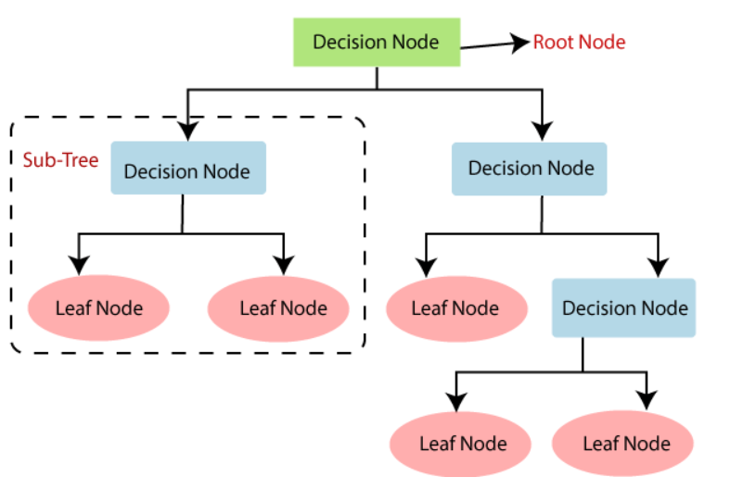
decision t r e e repre se nt ation

Slide 34
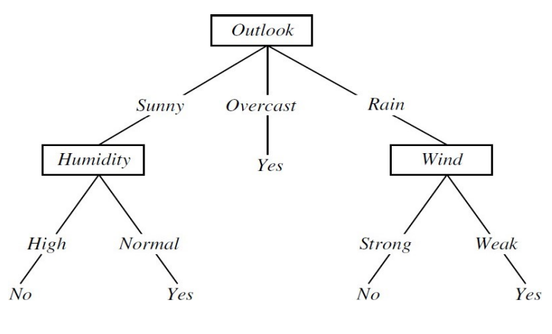
- tree to decide whether a person can play tennis or not

Slide 35
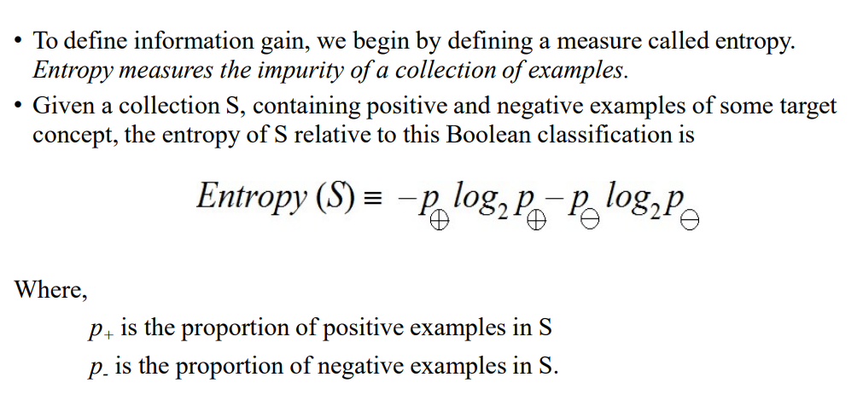

Slide 36
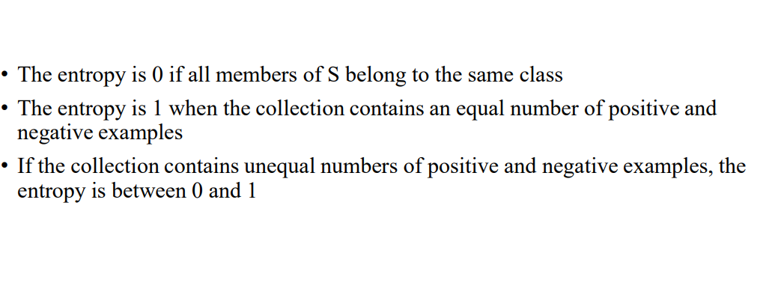

Slide 37
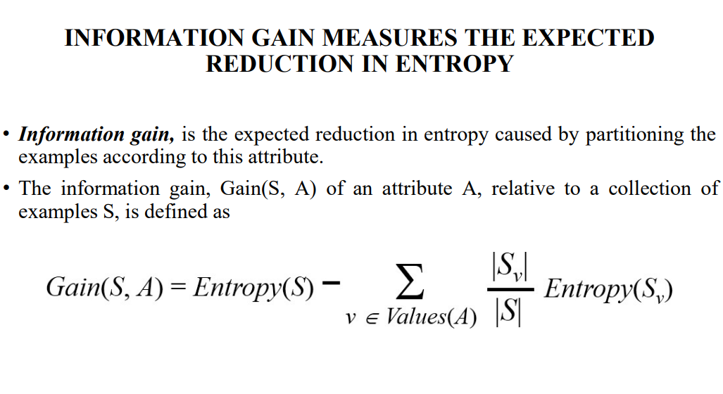

Slide 38
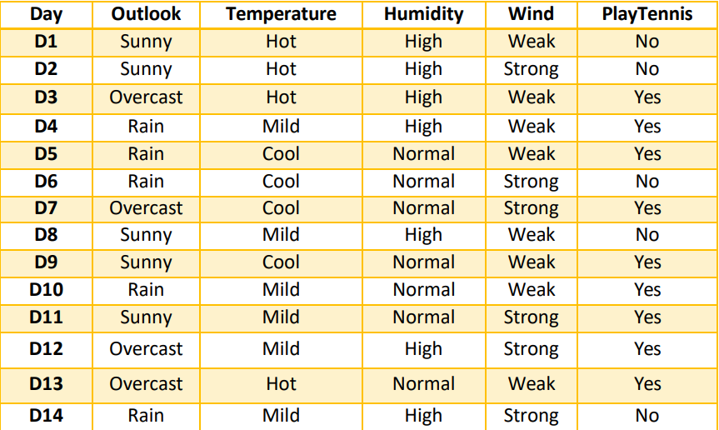

Slide 39
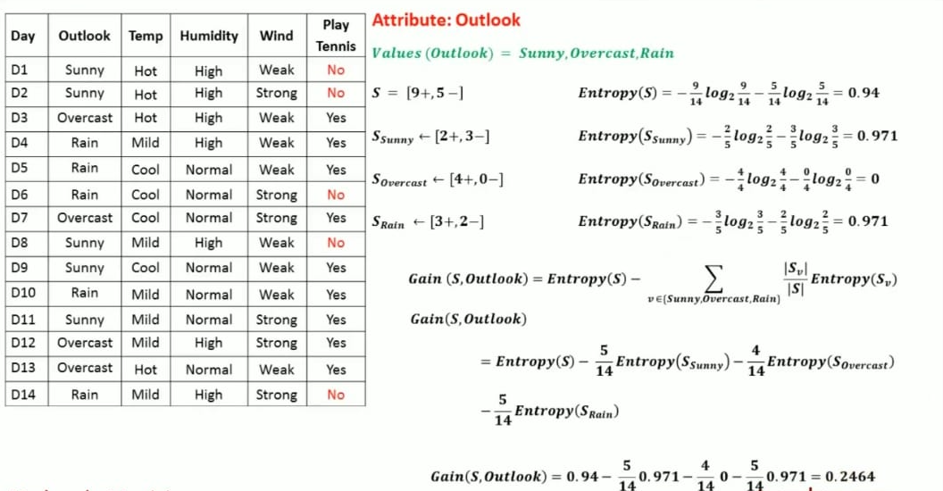

Slide 40
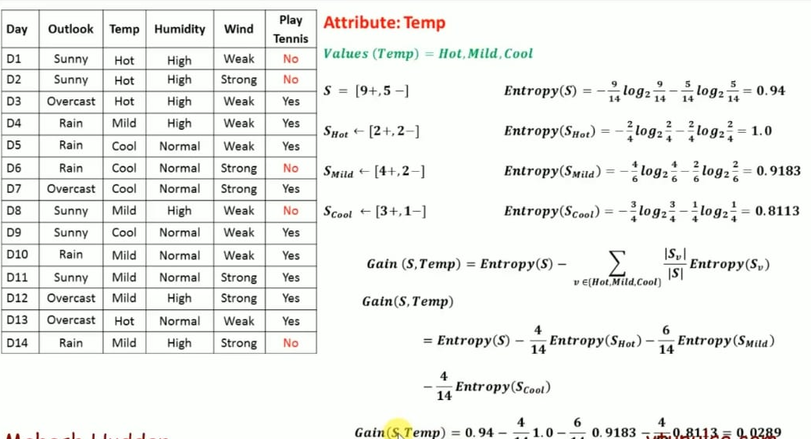

Slide 41
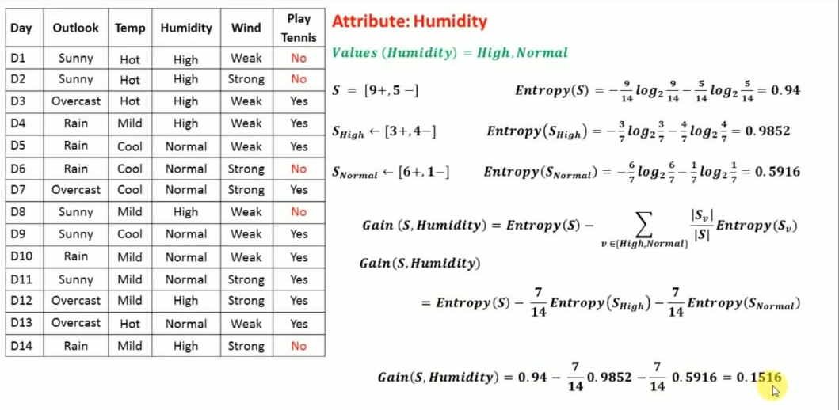

Slide 42
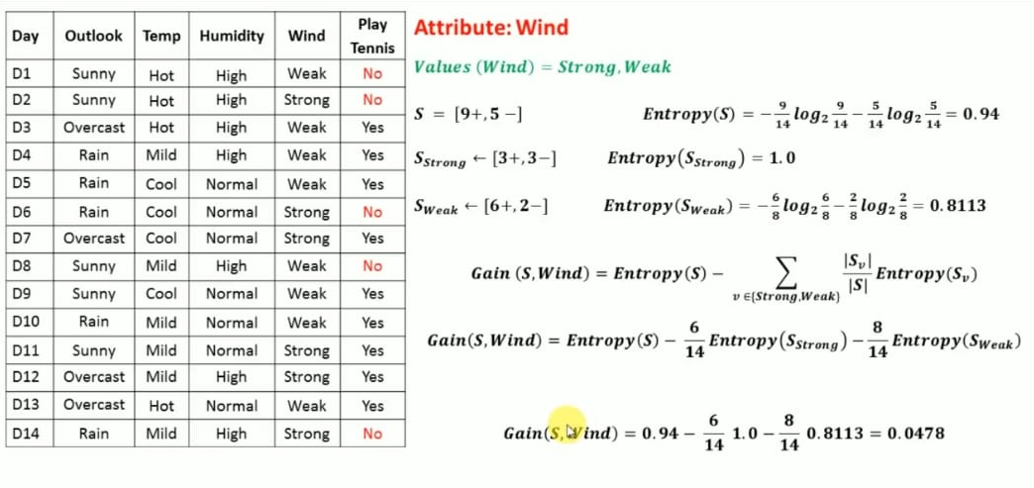

Slide 43
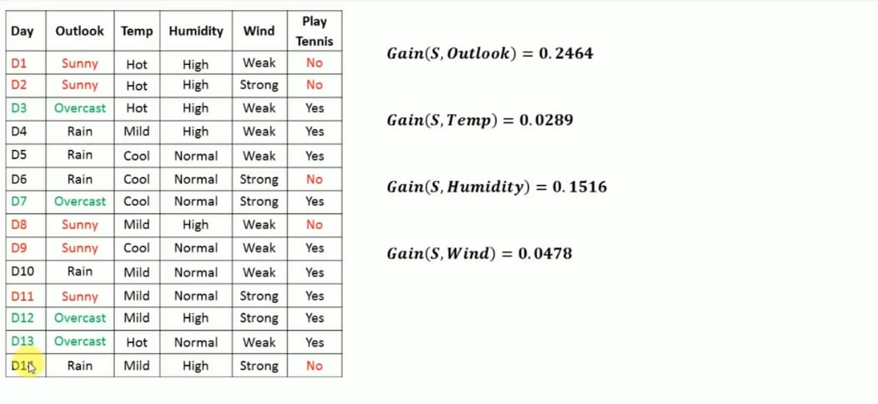

Slide 44
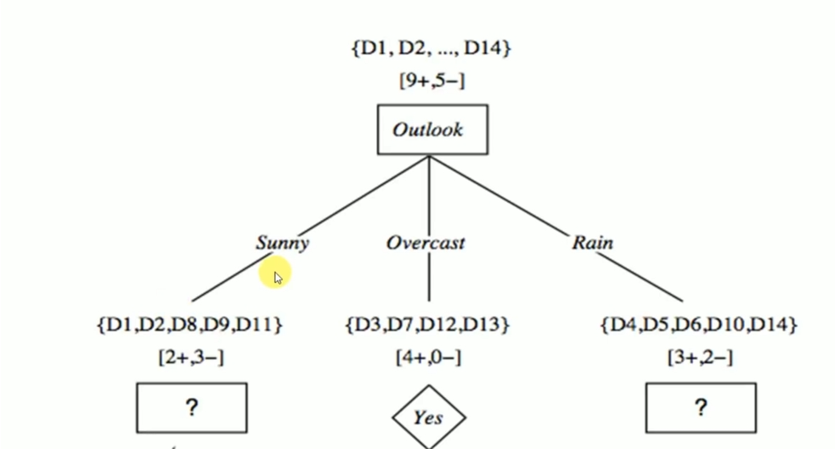

Slide 45
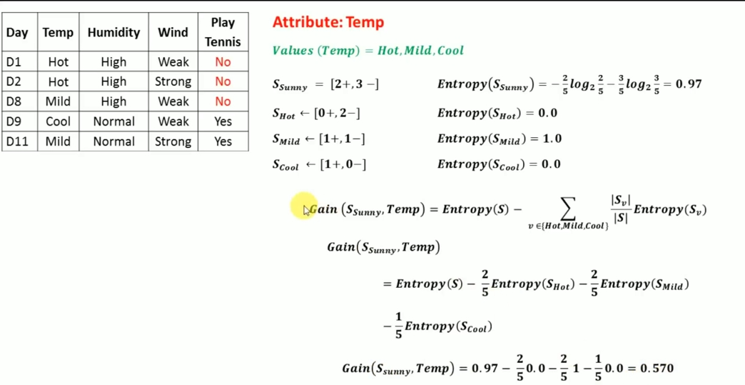

Slide 46
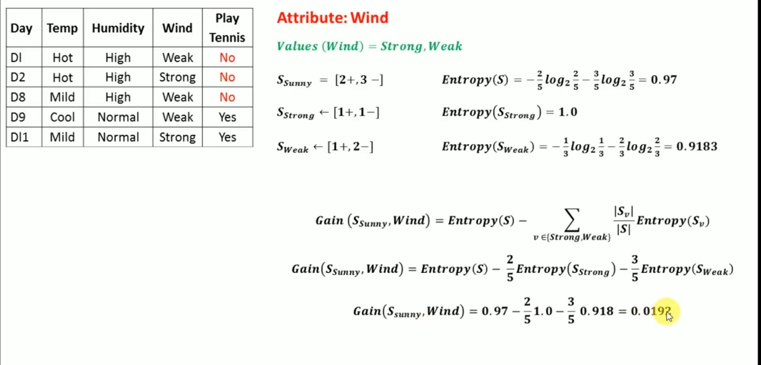

Slide 47
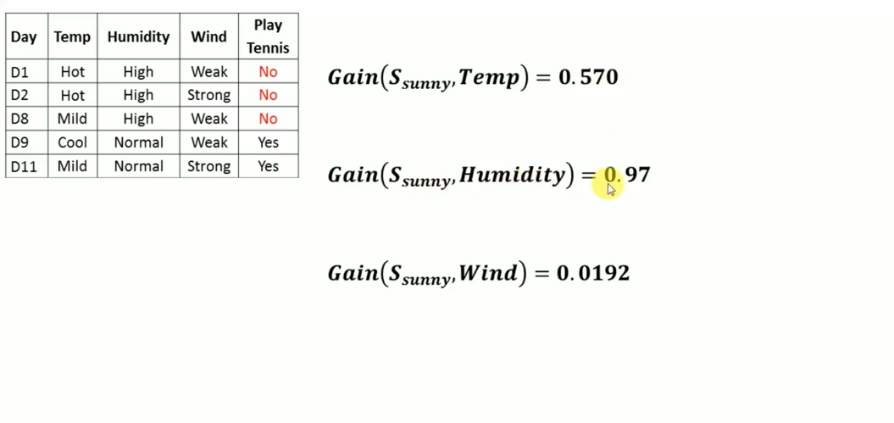

Slide 48
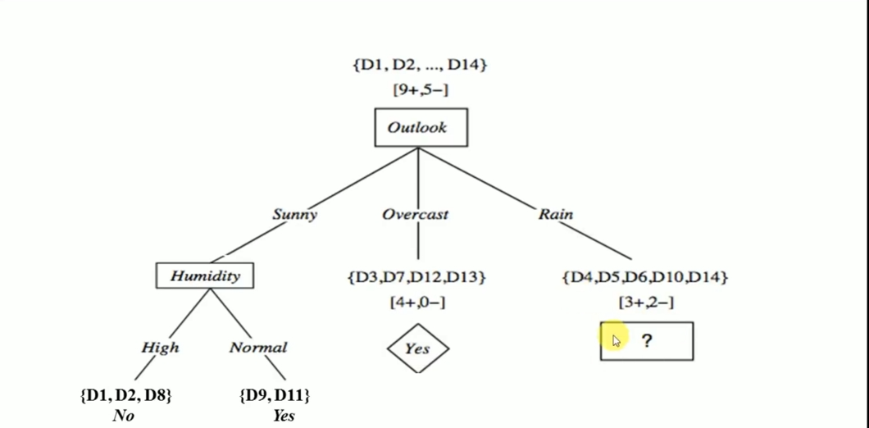

Slide 49
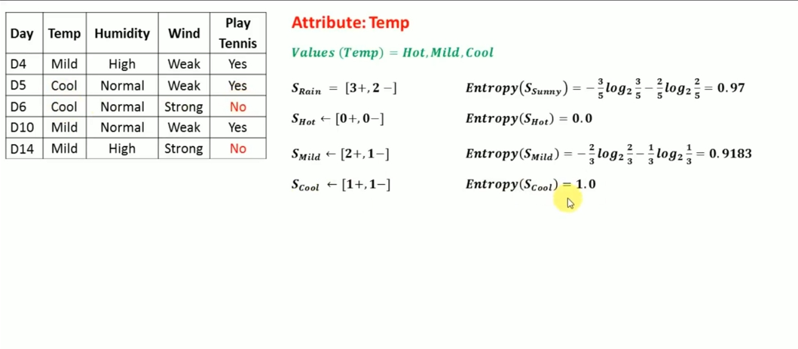

Slide 50
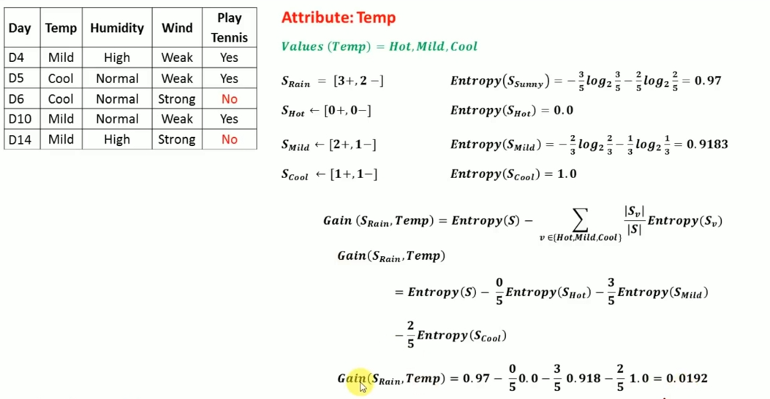

Slide 51
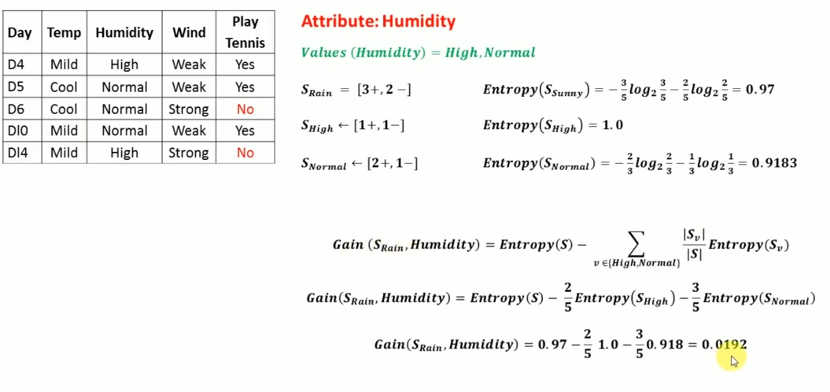

Slide 52
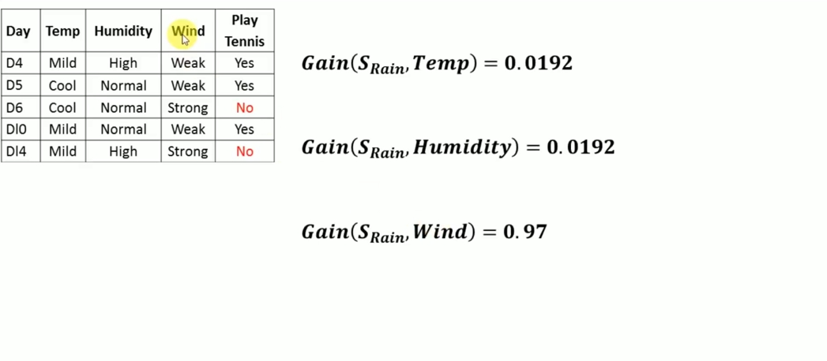

Slide 53
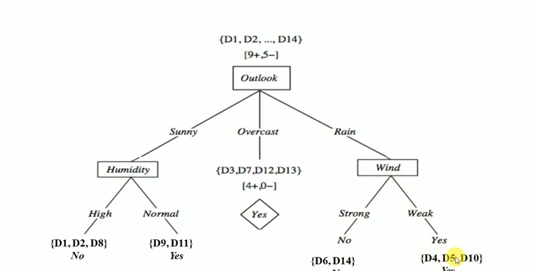

Slide 54
NAÏVE BAYES
Let's start with a basic introduction to the Bayes theorem, named after Thomas Bayes from the 1700s. The Naive Bayes classifier works on the principle of conditional probability, as given by the Bayes theorem.
If we toss two coins and look at all the different possibilities, we have the sample space as:{HH, HT, TH, TT}
The probability of getting two heads = 1/4
The probability of at least one tail = 3/4
The probability of the second coin being head given the first coin is tail = 1/2
The probability of getting two heads given the first coin is a head = 1/2
The Bayes theorem gives us the conditional probability of event A, given that event B has occurred.

Slide 55
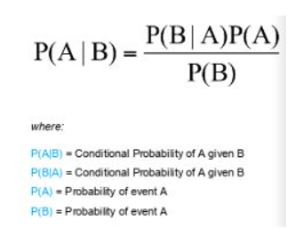
According to Bayes theorem:

Slide 56
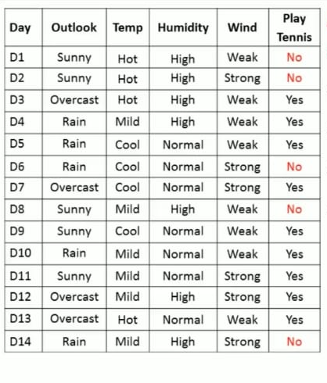
Example 1

Slide 57
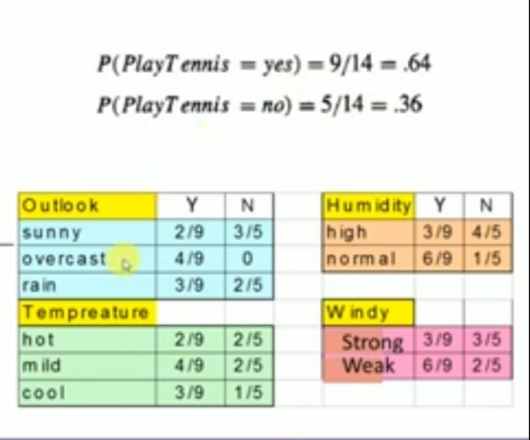

Slide 58
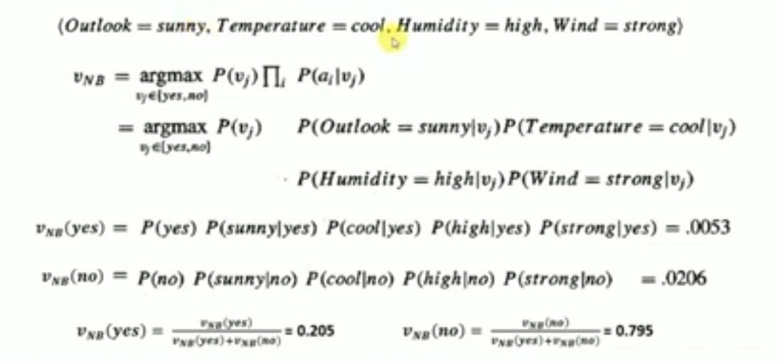

Slide 59
Assignment 1, 2
Problems in Decision tree
Advantages and disadvantages of naïve bayes classifier

Slide 60
MULTI CLASS CLASSIFICATION
For multi-class classification, many binary classification techniques are applicable.
The following well-known algorithms can be used for multi-class classification:
Progressive Boosting
Choice trees
Nearest K Neighbors
Rough Forest / Random Forest
Simple Bayes
Multi-class problems can be solved using algorithms created for binary classification.

Slide 61
KNN
K-Nearest Neighbour is one of the simplest Machine Learning algorithms based on Supervised Learning technique.
K-NN algorithm assumes the similarity between the new case/data and available cases and put the new case into the category that is most similar to the available categories.
K-NN algorithm stores all the available data and classifies a new data point based on the similarity. This means when new data appears then it can be easily classified into a well suite category by using K- NN algorithm.

Slide 62
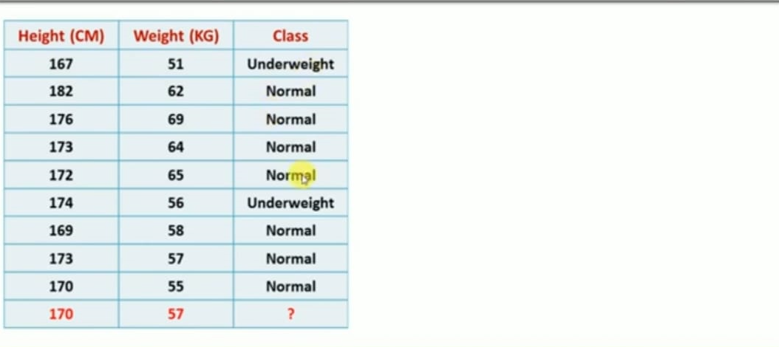

Slide 63
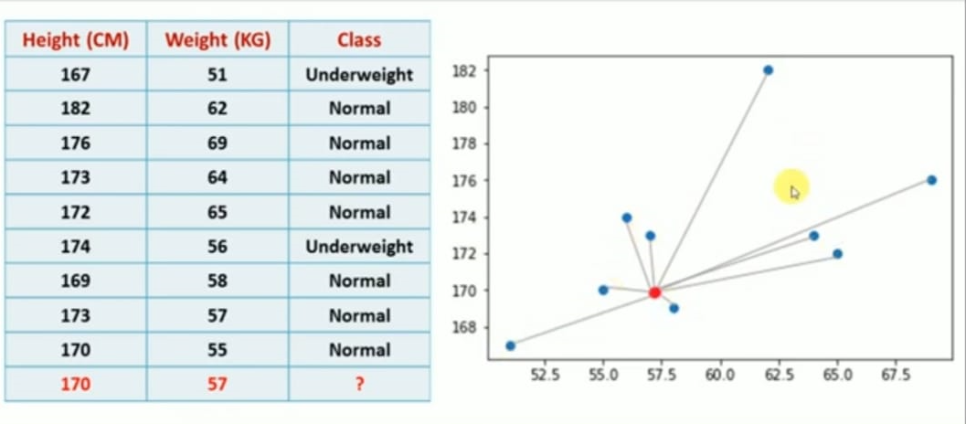
sar

Slide 64
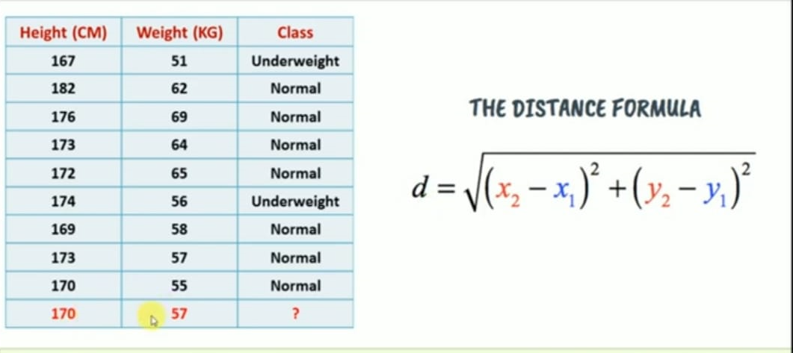

Slide 65
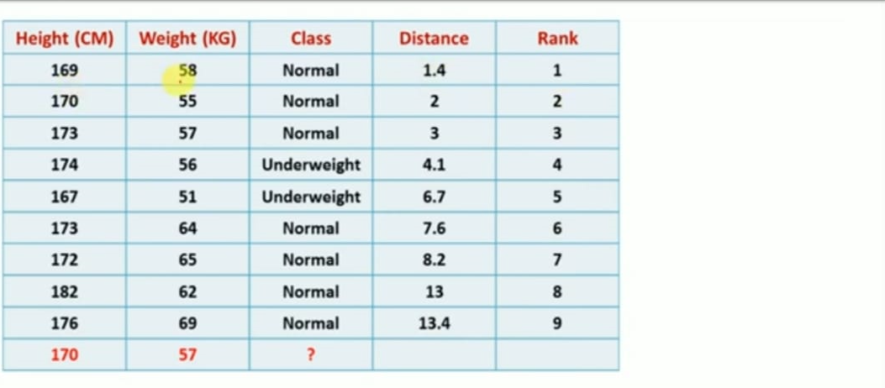

Slide 66
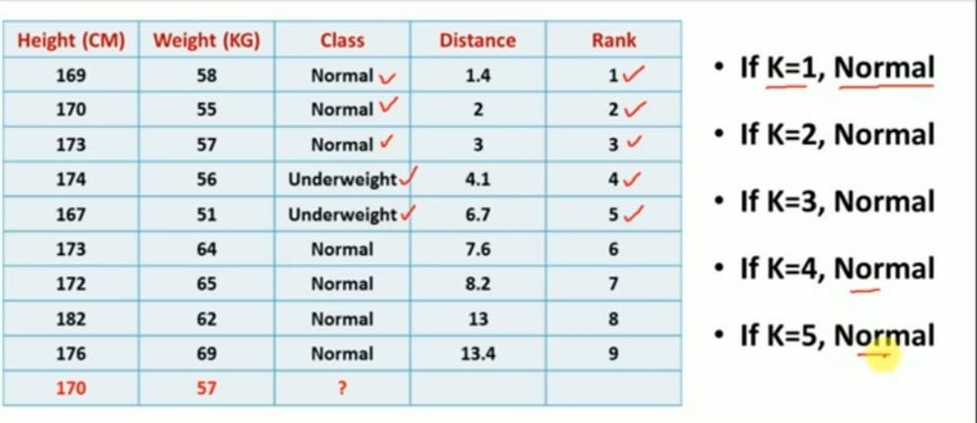

Slide 67
Random Forest Algorithm
"Random Forest is a classifier that contains a number of decision trees on various subsets of the given dataset and takes the average to improve the predictive accuracy of that dataset.“
The greater number of trees in the forest leads to higher accuracy and prevents the problem of overfitting.

Slide 68
Bagging
From the principle mentioned above, we can understand Random forest uses the Bagging code. Now, let us understand this concept in detail.
Bagging is also known as Bootstrap Aggregation used by random forest. The process begins with any original random data. After arranging, it is organized into samples known as Bootstrap Sample.
This process is known as Bootstrapping.Further, the models are trained individually, yielding different results known as Aggregation. In the last step, all the results are combined, and the generated output is based on majority voting. This step is known as Bagging and is done using an Ensemble Classifier.

Slide 69
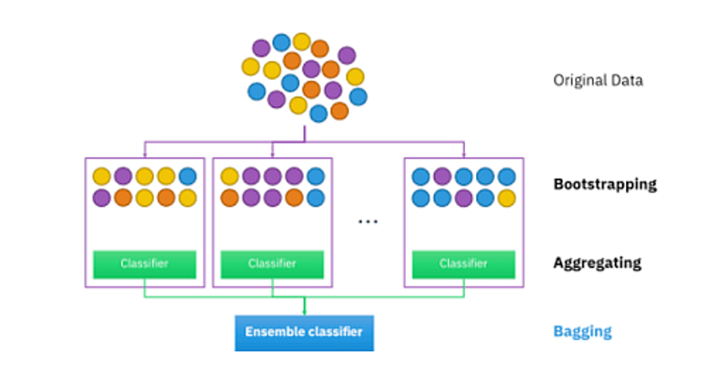
Bagging

Slide 70
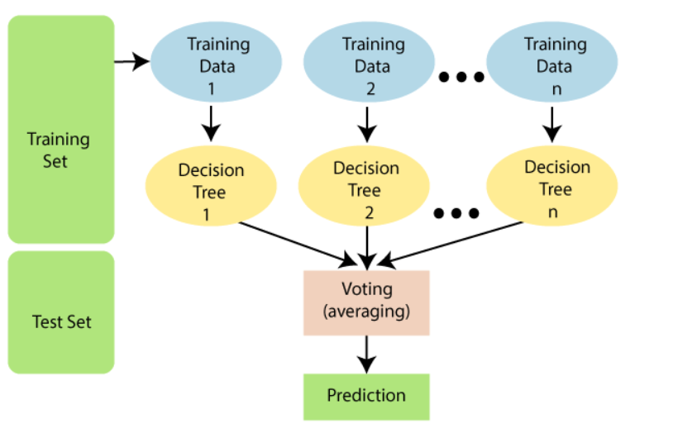

Slide 71
Assignment 3, 4
Features of Random forest
Difference between random forest and decision trees

Slide 72
UNSUPERVISED LEARNING
No labels are given to the learning algorithm, leaving it on its own to find structure in its input. Unsupervised learning can be a goal in itself

Slide 73
TYPES
Clustering
Association

Slide 74
clustering
Clustering is the task of dividing the population or data points into a number of groups such that data points in the same groups are more similar to other data points in the same group and dissimilar to the data points in other groups. It is basically a collection of objects on the basis of similarity and dissimilarity between them.

Slide 75
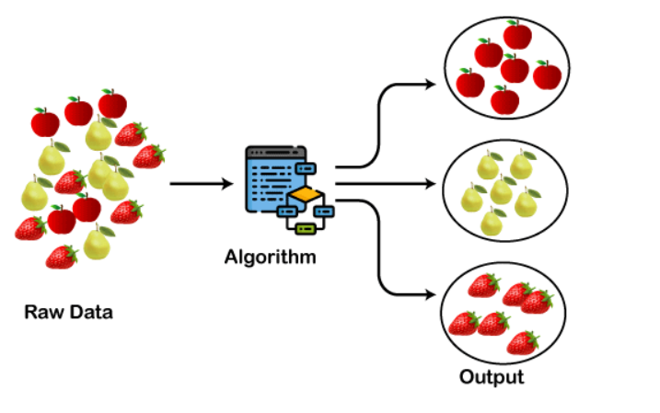

Slide 76
The clustering technique can be widely used in various tasks. Some most common uses of this technique are:
Market Segmentation
Statistical data analysis
Social network analysis
Image segmentation
Anomaly detection, etc.
Apart from these general usages, it is used by the Amazon in its recommendation system to provide the recommendations as per the past search of products. Netflix also uses this technique to recommend the movies and web-series to its users as per the watch history.

Slide 77
Types of Clustering Methods
The clustering methods are broadly divided into Hard clustering (datapoint belongs to only one group) and Soft Clustering (data points can belong to another group also).

Slide 78
Partitioning Clustering
Density-Based Clustering
Distribution Model-Based Clustering
Hierarchical Clustering
Fuzzy Clustering

Slide 79
Partitioning Clustering
It is a type of clustering that divides the data into non-hierarchical groups. It is also known as the centroid-based method. The most common example of partitioning clustering is the K-Means Clustering algorithm.
In this type, the dataset is divided into a set of k groups, where K is used to define the number of pre-defined groups. The cluster center is created in such a way that the distance between the data points of one cluster is minimum as compared to another cluster centroid.

Slide 80
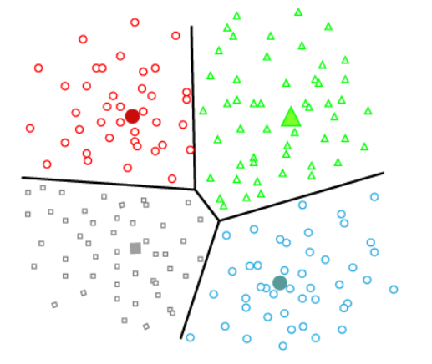

Slide 81
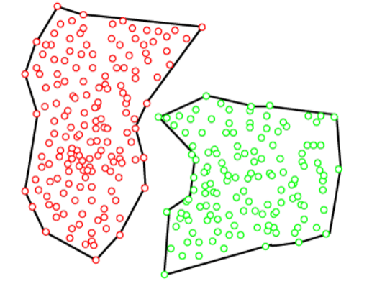
Density-Based Clustering
The density-based clustering method connects the highly-dense areas into clusters, and the arbitrarily shaped distributions are formed as long as the dense region can be connected.

Slide 82


Slide 83

Example of k means

Slide 84


Slide 85


Slide 86


Slide 87


Slide 88


Slide 89


Slide 90
Pros n cons
Simple
Flexible
Suitable in large datasets
Efficient
Accuracy
Cons
Handle numerical data only
Specifying clusters earlier
Prediction issue

Slide 91
Assignment 5 n 6
Difference between supervised and unsupervised
Real world applications of k means

Slide 92
Reinforcement learning
Reinforcement Learning is a feedback-based Machine learning technique in which an agent learns to behave in an environment by performing the actions and seeing the results of actions. For each good action, the agent gets positive feedback, and for each bad action, the agent gets negative feedback or penalty.
In Reinforcement Learning, the agent learns automatically using feedbacks without any labeled data
RL solves a specific type of problem where decision making is sequential, and the goal is long-term, such as game-playing, robotics, etc
"Reinforcement learning is a type of machine learning method where an intelligent agent (computer program) interacts with the environment and learns to act within that.".

Slide 93

Example of RL

Slide 94
Example: Suppose there is an AI agent present within a maze environment, and his goal is to find the diamond. The agent interacts with the environment by performing some actions, and based on those actions, the state of the agent gets changed, and it also receives a reward or penalty as feedback.
The agent continues doing these three things (take action, change state/remain in the same state, and get feedback), and by doing these actions, he learns and explores the environment.
The agent learns that what actions lead to positive feedback or rewards and what actions lead to negative feedback penalty. As a positive reward, the agent gets a positive point, and as a penalty, it gets a negative point.

Slide 95
Key Features of Reinforcement Learning
In RL, the agent is not instructed about the environment and what actions need to be taken.
It is based on the hit and trial process.
The agent takes the next action and changes states according to the feedback of the previous action.
The agent may get a delayed reward.

Slide 96
Terms used in Reinforcement Learning
Agent(): An entity that can perceive/explore the environment and act upon it.
Environment(): A situation in which an agent is present or surrounded by. In RL, we assume the stochastic environment, which means it is random in nature.
Action(): Actions are the moves taken by an agent within the environment.
State(): State is a situation returned by the environment after each action taken by the agent.
Reward(): A feedback returned to the agent from the environment to evaluate the action of the agent.
Policy(): Policy is a strategy applied by the agent for the next action based on the current state.
Value(): represent how good is a state for an agent to be in. .
Q-value(): It is mostly similar to the value, but it takes one additional parameter as a current action (a).

Slide 97


Slide 98
Understanding Logistic Regression
Logistic regression is basically a supervised classification algorithm. In a classification problem, the target variable(or output), y, can take only discrete values for a given set of features(or inputs), X.
It is used for predicting the categorical dependent variable using a given set of independent variables.
Contrary to popular belief, logistic regression IS a regression model. The model builds a regression model to predict the probability that a given data entry belongs to the category numbered as “1”. Just like Linear regression assumes that the data follows a linear function, Logistic regression models the data using the sigmoid function.

Slide 99

Logistic Regression is much similar to the Linear Regression except that how they are used. Linear Regression is used for solving Regression problems, whereas Logistic regression is used for solving the classification problems.

Slide 100
Logistic Function (Sigmoid Function):
The sigmoid function is a mathematical function used to map the predicted values to probabilities.
It maps any real value into another value within a range of 0 and 1.
The value of the logistic regression must be between 0 and 1, which cannot go beyond this limit, so it forms a curve like the "S" form.
The S-form curve is called the Sigmoid function or the logistic function.
In logistic regression, we use the concept of the threshold value, which defines the probability of either 0 or 1. Such as values above the threshold value tends to 1, and a value below the threshold values tends to 0.

Slide 101
Assumptions for Logistic Regression:
The dependent variable must be categorical in nature.
The independent variable should not have multi-collinearity.
Types of Logistic Regression:
Type of Logistic Regression:
On the basis of the categories, Logistic Regression can be classified into three types:
Binomial: In binomial Logistic regression, there can be only two possible types of the dependent variables, such as 0 or 1, Pass or Fail, etc.
Multinomial: In multinomial Logistic regression, there can be 3 or more possible unordered types of the dependent variable, such as "cat", "dogs", or "sheep"
Ordinal: In ordinal Logistic regression, there can be 3 or more possible ordered types of dependent variables, such as "low", "Medium", or "High".

Slide 102
Support Vector Machine Algorithm
Support Vector Machine or SVM is one of the most popular Supervised Learning algorithms, which is used for Classification as well as Regression problems. However, primarily, it is used for Classification problems in Machine Learning.
The goal of the SVM algorithm is to create the best line or decision boundary that can segregate n-dimensional space into classes so that we can easily put the new data point in the correct category in the future. This best decision boundary is called a hyperplane.
SVM chooses the extreme points/vectors that help in creating the hyperplane. These extreme cases are called as support vectors, and hence algorithm is termed as Support Vector Machine.

Slide 103

Decision boundary or hyperplane

Slide 104

Example of SVM
Suppose we see a strange cat that also has some features of dogs, so if we want a model that can accurately identify whether it is a cat or dog, so such a model can be created by using the SVM algorithm. We will first train our model with lots of images of cats and dogs so that it can learn about different features of cats and dogs, and then we test it with this strange creature. So as support vector creates a decision boundary between these two data (cat and dog) and choose extreme cases (support vectors), it will see the extreme case of cat and dog. On the basis of the support vectors, it will classify it as a cat.
SVM algorithm can be used for Face detection, image classification, text categorization, etc.

Slide 105

where SVMs are used the most
SVMs are popular in various applications such as image classification, natural language processing, bioinformatics, and more.
Facial Expression Classification –
Support vector machines (SVMs) is a binary classification technique.
Image-based analysis and classification tasks.
Geo-spatial data-based applications.
Text-based applications.
Computational biology.
Security-based applications.
Chaotic systems control.

Slide 106
Thank You

